Slide 1

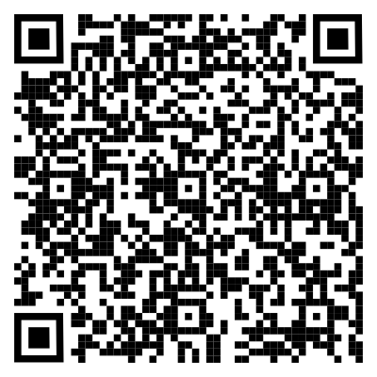


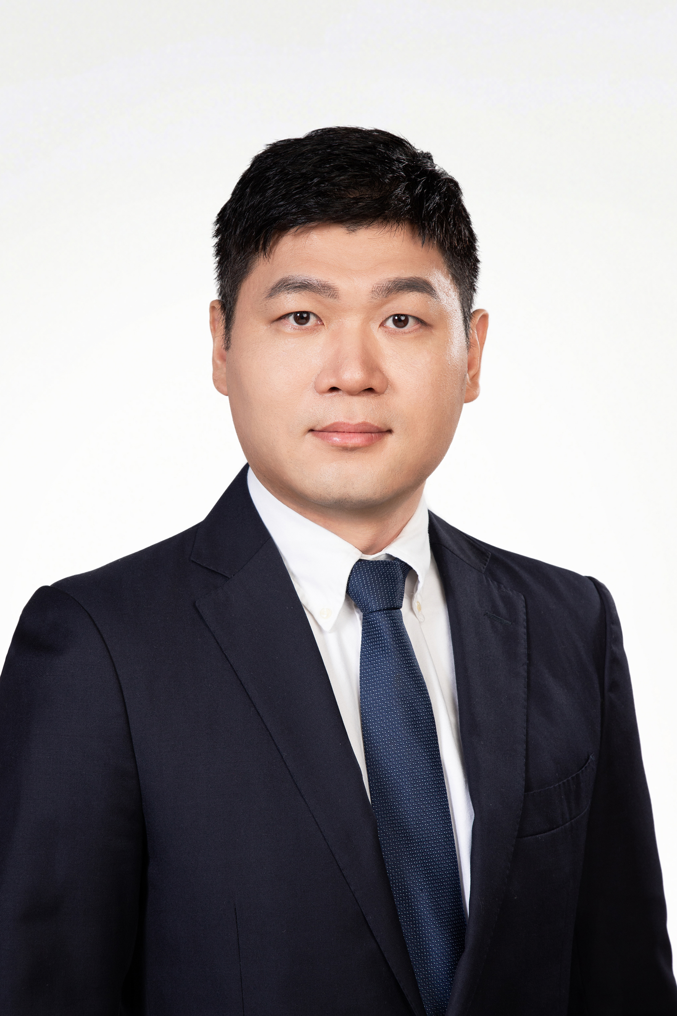




Translation initiation in eukaryotes: from viruses to human pathological cases
Time (China): 2024-11-5 09:00 AM
Time (EST): 2024-11-4 08:00 PM
Zoom ID: 811 0745 9920
Passcode: 123456
Zoom meeting link:
https://us06web.zoom.us/j/81107459920?pwd=FywefBaBGMOfR3vdauiXHWF7sTU9ua.1
Bilibili：https://live.bilibili.com/26427894
Franck MARTIN
Architecture et Réactivité de l’ARN
Institut de Biologie Moléculaire et Cellulaire du CNRS
Strasbourg, France
Abstract:
In eukaryotes, translation initiation is a highly regulated process involving cis-regulatory sequences on messenger RNA and eukaryotic initiation factors (eIF). Canonical translation is cap-dependent, leading to the assembly of an elongation-competent ribosome at the start codon. However, alternative cap-independent translation initiation mechanisms are activated in response to stimuli such as viral infections and cellular stresses.
We studied translation mechanisms during SARS-CoV-2 infection. The viral protein NSP1 binds to host ribosomes, inhibiting cellular translation to favor viral translation, while also acting as an RNA endonuclease that cleaves host mRNAs. Dysregulation of translation initiation can lead to human pathologies. For instance, in Amyotrophic Lateral Sclerosis, Repeat-Associated Non AUG (RAN) translation produces toxic polypeptides that damage motor neurons. In Alzheimer’s disease, alternative translation initiation of Tau mRNAs results in a truncated, aggregation-prone form of the Tau protein.
HOST＆PANELISTS
Host：Zhichao Miao
Guangzhou Laboratory
Guangzhou Medical University
Lin Huang
Sun Yat-sen University
Jianhua Yang
Sun Yat-sen University
Jinkai Wang
Sun Yat-sen University
Sponsors

Slide 2
真核生物的翻译起始：从病毒到人类病理病例
Time (China): 2024-11-5 09:00 AM
Time (EST): 2024-11-4 08:00 PM
Zoom ID: 811 0745 9920
Passcode: 123456
Zoom meeting link:
https://us06web.zoom.us/j/81107459920?pwd=FywefBaBGMOfR3vdauiXHWF7sTU9ua.1
Bilibili：https://live.bilibili.com/26427894
Franck MARTIN
RNA结构和反应性
CNRS分子与细胞生物学研究所
法国特斯拉斯堡
摘要：
在真核生物中，翻译起始是一个高度受调控的过程，涉及信使RNA上的顺式调控序列和真核起始因子(eIF)。规范翻译依赖于帽子，导致在起始密码子处组装具有延伸能力的核糖体。然而，在病毒感染和细胞应激等刺激下，替代的不依赖帽子的翻译起始机制会被激活。
我们研究了SARS-CoV-2感染期间的翻译机制。病毒蛋白NSP1与宿主核糖体结合，抑制细胞翻译以利于病毒翻译，同时还充当切割宿主mRNA的RNA内切酶。翻译起始失调可导致人类病理。例如，在肌萎缩侧索硬化症中，重复相关非AUG(RAN) 翻译会产生损害运动神经元的毒性多肽。在阿尔茨海默病中，Tau mRNA的替代翻译起始导致Tau蛋白的截短、易聚集形式。
主持人＆嘉宾
Host：Zhichao Miao
Guangzhou Laboratory
Guangzhou Medical University
Lin Huang
Sun Yat-sen University
Jianhua Yang
Sun Yat-sen University
Jinkai Wang
Sun Yat-sen University
赞助商

